Slide 1
…we love humidity

Slide 2
Humidifier Applications
PROCESSING & STORAGE
Prevention of electrostatic discharge, material drying, and product damage
INDUSTRIAL
Printing & packaging
Electronics
Data Centers
Automotive
Textile
Tobacco
Wood processing
Supermarkets
Museums
Manufacturing
HEALTH & PRODUCTIVITY Improvement of employee health (eyes/skin/throat), and reduced absenteeism
APPLICATIONS
Offices
Call-centers
Hospitals
Airports
Education
Notes:
First of all what is HP?
HP is a high pressure fogging system. This means the we are using a pump to bring water to a 1000 psi, supplying it to nozzles in a duct or air handling unit and then spraying the fog into the airstream.
HP is modular; by changing the modules we can create a system that meats the unique requirements of any project. 1 size does not fit all!
Using fogging systems can be a very efficient way to humidify…which we will talk about next!

Slide 3
Humidification for Residential Applications
Prevents electrostatic charges and shocks
Protects paintings and antiques
Reduces drying damage to furniture and wooden floors
Helps prevent colds and flu
Eliminates dehydration of the skin and mucous membranes
Reduces headaches

Slide 4
Cold and Flu Transmission
Contact Transmission
Occurs through Direct contact with others and indirect contact with contaminated objects.

Slide 5
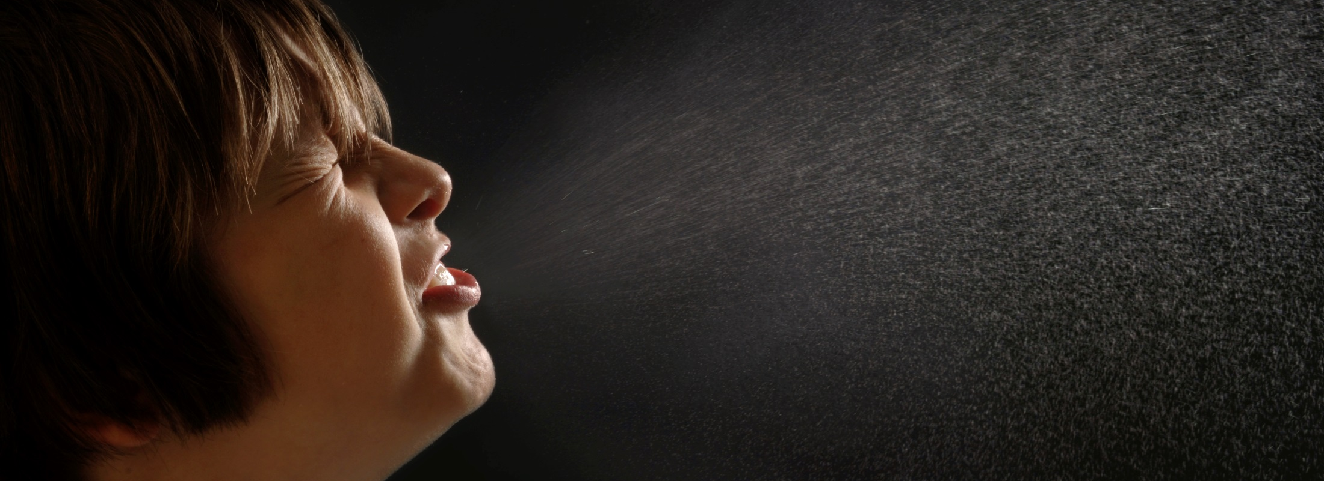
Cold and Flu Transmission
Droplet Infection
Occurs through speaking, coughing, and sneezing

Slide 6
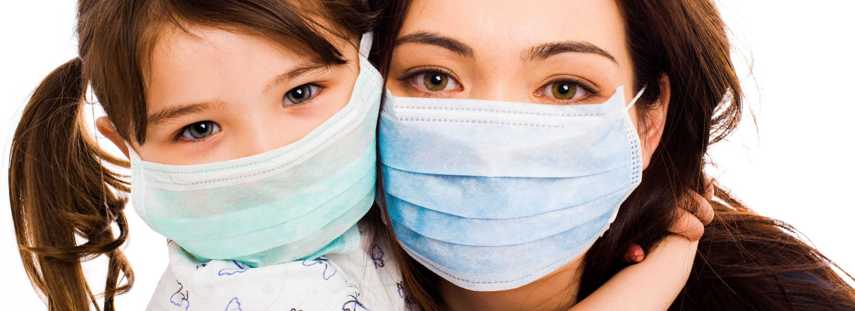
Cold and Flu Transmission
Aerosol Transmission
Occurs when virus is transmitted over distances by wind or ventilation.

Slide 7
Why Humidification?
Aerosol transmission is a proven infection mechanism for:
Flu viruses
Cold viruses
Chicken pox, measles, and rubella
SARS virus

Slide 8
Why Humidification?
Seven clinical trials from 1963 to 1985 showed that the incidence of colds can be reduced by up to 50% by maintaining the relative humidity between 45 and 55%.
Ritzel G, Sozialmedizinische Erhebung zur Pathogenese und Prophylaxe von Erkältungskrankheiten, sog. «Kindergartenstudie» Zeitschrift für Präventivmedizin 1966, 11. 9-16
Sale C, Humidification to Reduce Respiratory Illnesses in Nursery School Children, Southern Medical Journal, July 1972, Vol 65
Green GH, Winter humidity and related absenteeism in Canadian hospitals, Digest of the 3rd. CMBES
Green GH, The effect of indoor relative humidity on absenteeism and colds in schools, ASHRAE Trans., Vol. 80, Part II
Gelperin A, Humidification and upper respiratory infection incidence, Heating, Piping and Air Conditioning, 45:3, 1973

Slide 9
Why Humidification?
Studies within the last five years show that
Aerosol Transmission
is probably the most important
method of indoor virus transmission during winter season.
Cowling BJ, Aerosol transmission is an important mode of influenza. A virus spread, Nat Commun. 2013;4:1935
Weber TP, Stilianakis NI, Inactivation of influenza A viruses in the environment and modes of transmission, a critical review, Journal of Infection, Volume 57, Issue 5, November 2008

Slide 10
Why Humidification?
Dry air allows the transmission of viruses from suspended aerosols. (1, 2)
Dry air prolongs the survival of viruses in aerosols. (2)
Lowen AC., Mubareka S., Steel J., Palese P., Influenza Virus Transmission is Dependent on Relative Humidity and Temperature, PLoS One Pathogens Okt. 2007/Vol. 3/Issue 10/e151
Noti JD, Blanchere FM, McMillen CM, Lindsley WG, Kashon ML, SLaughter DR, Beezhold DH. High Humidity Leads to Loss of Infectious Influenza Virus from Simulated Coughs, PLoS One. 2013;8(2):e57485

Slide 11
Why humidification?
In humid air, the infectivity of viruses is reduced by 90% within one hour.
Noti JD, High Humidity Leads to Loss of Infectious Influenza Virus from Simulated Coughs, PLoS One. 2013;8(2):e57485

Slide 12
…and at the office work place?
Employees must feel comfortable at work. Motivation, performance and health can be positively influenced by a well designed and properly maintained indoor environment.
Intensive screen work, speaking-intensive activities and overheated offices can lead, in combination with low indoor humidity, to significant health risks.
Especially in the winter months respiratory infections, swallowing discomfort, sore throat and burning eyes are common symptoms.

Slide 13
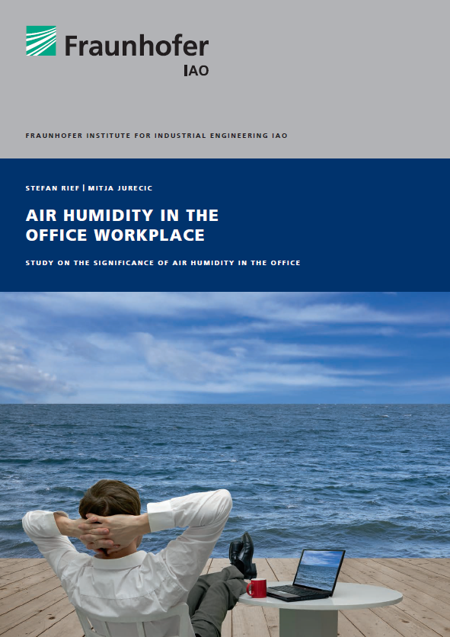
Humidification Matters
A recent study/survey from the Fraunhofer Institute for Industrial Engineering IAO shows, that humidity has a direct impact
on a person’s well-being, motivation and performance.

Slide 14
Humidification Matters
SBiB-Studie (Schweizerische Befragung in Büros), Hochschule Luzern, April 2010; befragt wurden 1230 Personen
AOK Rheinlandbericht 2009, Institut für betriebliche Gesundheitsförderung
BAuA Bundesanstalt für Arbeitsschutz und Arbeitsmedizin 2008
Dry air affects the office workplace
About 35% of office workers feel too dry air often/always is an infringing factor at the working place.¹⁾
Symptoms of illness also depend on low humidity levels Symptoms of mucous membranes (respiratory tract, throat, voice), eyes and skin are strongly related to low humidity levels in the office environment.¹⁾
Respiratory diseases are the most frequent cause of absenteeism
More than a quarter of all disease cases (27.7%) are due to respiratory diseases.²⁾ In Germany more than 50 million working disability days, lead to a productivity lost
of 4.5 billion Euro (approx. 5 billion USD).³⁾

Slide 15
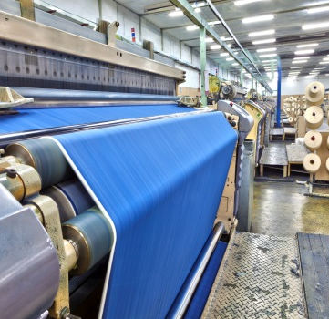
Summary: Why Humidify?
People, Products and Process all depend on humidity control
Whether to keep the presses rolling, protect priceless works of art, or ensure health of employees, humidity is a crucial factor.
Virus transmission occurs more readily in dry environments Humid air reduces viability and transmission of viral infections. Reducing viral infections means a healthier and more productive workplace.
Absenteeism costs money and reduces productivity
Respiratory infections are one of the leading causes of absenteeism and carry significant costs for employers and productivity. Reducing infections through a healthy indoor environment saves money for employers.

Slide 16
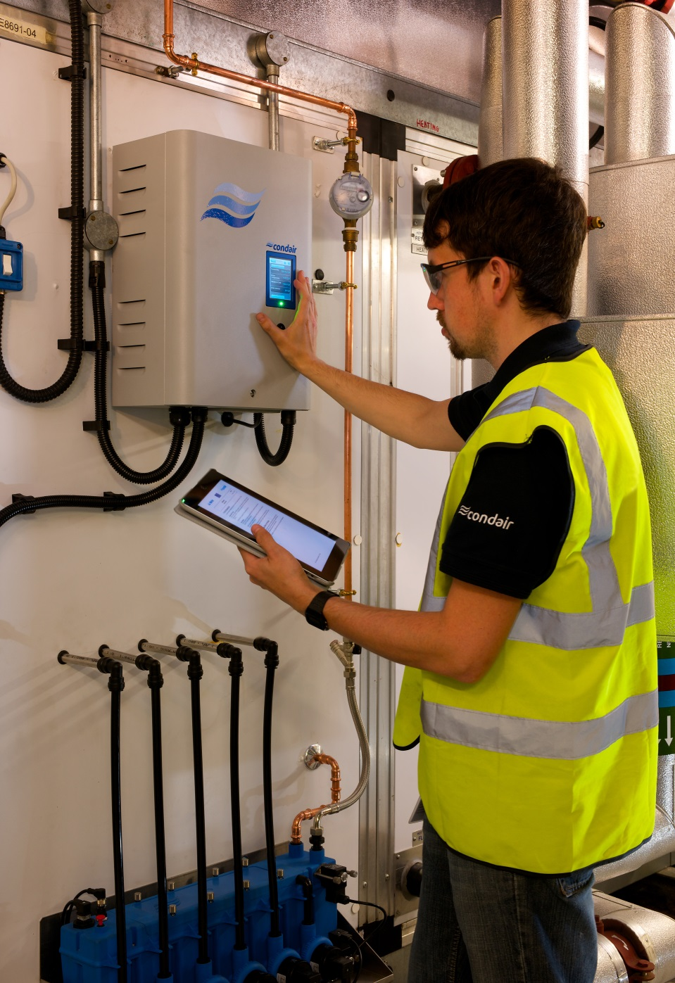
Health and Productivity Through Air and Water
Nortec is a member of the Condair Group, the worlds leading manufacturer of commercial and industrial humidification.
Nortec is passionate about promoting best practice in humidification and evaporative cooling and our team includes some of the foremost humidification experts in the world.
Visit www.humidity.com for application expertise and information on our wide range of humidity control solutions.

Slide 17
When you need humidity…

